Slide 1

About the Presentations
The presentations cover the objectives found in the opening of each chapter
All chapter objectives are listed in the beginning of each presentation
You may customize the presentations to fit your class needs
Some figures from the chapters are included; a complete set of images from the book can be found on the Instructor Resources disc

Slide 2

Java Programming :Introduction
An Overview of Computers and
Programming Languages

Slide 3
Chapter Objectives
Learn about different types of computers
Explore the hardware and software components of a computer system
Learn about the language of a computer
Learn about the evolution of programming languages
Examine high-level programming languages

Slide 4
Chapter Objectives (continued)
Discover what a compiler is and what it does
Examine how a Java program is processed
Learn what an algorithm is and explore problem-solving techniques
Become aware of structured and object-oriented programming design methodologies

Slide 5
Introduction
Computers have greatly affected our daily lives – helping us complete many tasks
Computer programs (software) are designed specifically for each task
Software is created with programming languages
Java is an example of a programming language

Slide 6
An Overview of the History of Computers
The first device known to carry out calculations was the abacus
The abacus uses a system of sliding beads on a rack for addition and subtraction
Blaise Pascal invented the calculating device called the Pascaline

Slide 7
Hardware Components of a Computer
Central processing unit (CPU)
Main memory

Slide 8
Central Processing Unit
Arithmetic and logical operations are carried out inside the CPU

Slide 9
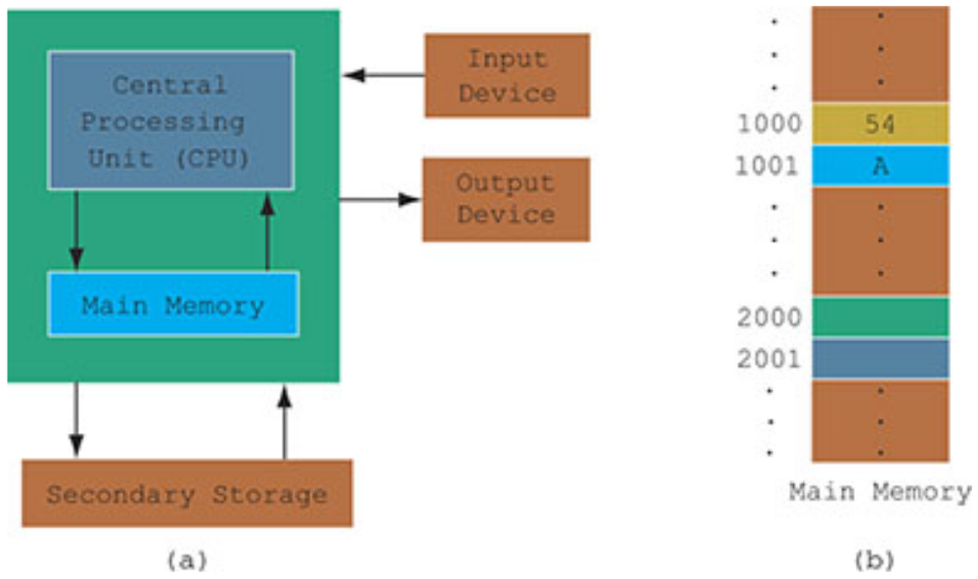
Central Processing Unit and Main Memory
Figure 1-1

Slide 10
Main Memory
Ordered sequence of cells (memory cells)
Directly connected to CPU
All programs must be brought into main memory before execution
When power is turned off, everything in main memory is lost

Slide 11
Secondary Storage
Provides permanent storage for information
Examples of secondary storage:
  Hard disks
  Floppy disks
  Flash memory
  ZIP disks
  CD-ROMs
  Tapes

Slide 12
Input Devices
Definition: devices that feed data and computer programs into computers
Examples
  Keyboard
  Mouse
  Secondary storage

Slide 13
Output Devices
Definition: devices that the computer uses to display results
Examples
  Printer
  Monitor
  Secondary storage

Slide 14
Software
Software consists of programs written to perform specific tasks
Two types of programs
  System programs
  Application programs

Slide 15
System Programs
System programs control the computer
The operating system is first to load when you turn on a computer

Slide 16
Operating System (OS)
OS monitors overall activity of the computer and provides services
Example services
  Memory management
  Input/output
  Activities
  Storage management

Slide 17
Application Programs
Written using programming languages
Perform a specific task
Run by the OS
Example programs
  Word processors
  Spreadsheets
  Games

Slide 18
Language of a Computer
Machine language: the most basic language of a computer
A sequence of 0s and 1s
Every computer directly understands its own machine language
A bit is a binary digit, 0 or 1
A byte is a sequence of eight bits
Java Programming: From Problem Analysis to Program Design, 5e

Slide 19
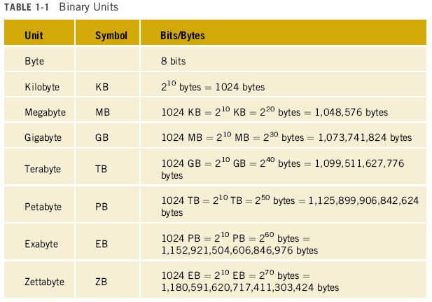
Language of a Computer (continued)

Slide 20
Evolution of Programming Languages
Early computers programmed in machine language
Assembly languages were developed to make programmer’s job easier
In assembly language, an instruction is an easy-to-remember form called a mnemonic
Assembler: translates assembly language instructions into machine language

Slide 21
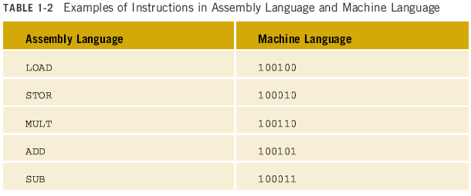
Instructions in Assembly and Machine Language

Slide 22
Evolution of Programming Languages
High-level languages make programming easier
Closer to spoken languages
Examples
  Basic
  FORTRAN
  COBOL
  C/C++
  Java
Java Programming: From Problem Analysis to Program Design, 5e

Slide 23
Evolution of Programming Languages (continued)
To run a Java program:
  Java instructions need to be translated into an intermediate language called bytecode
  2. Then the bytecode is interpreted into a particular machine language

Slide 24
Evolution of Programming Languages (continued)
Compiler: a program that translates a program written in a high-level language into the equivalent machine language
  In the case of Java, this machine language is the bytecode
Java Virtual Machine (JVM): hypothetical computer developed to make Java programs machine independent

Slide 25
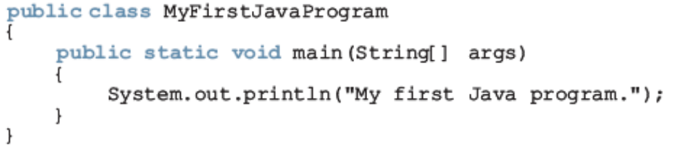
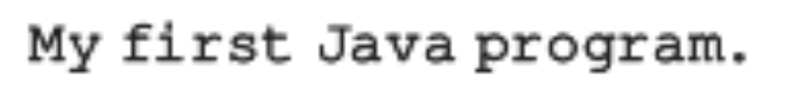
A Java Program
Output:

Slide 26
Processing a Java Program
Two types of Java programs: applications and applets
Source program: written in a high-level language
Loader: transfers the compiled code (bytecode) into main memory
Interpreter: reads and translates each bytecode instruction into machine language and then executes it

Slide 27
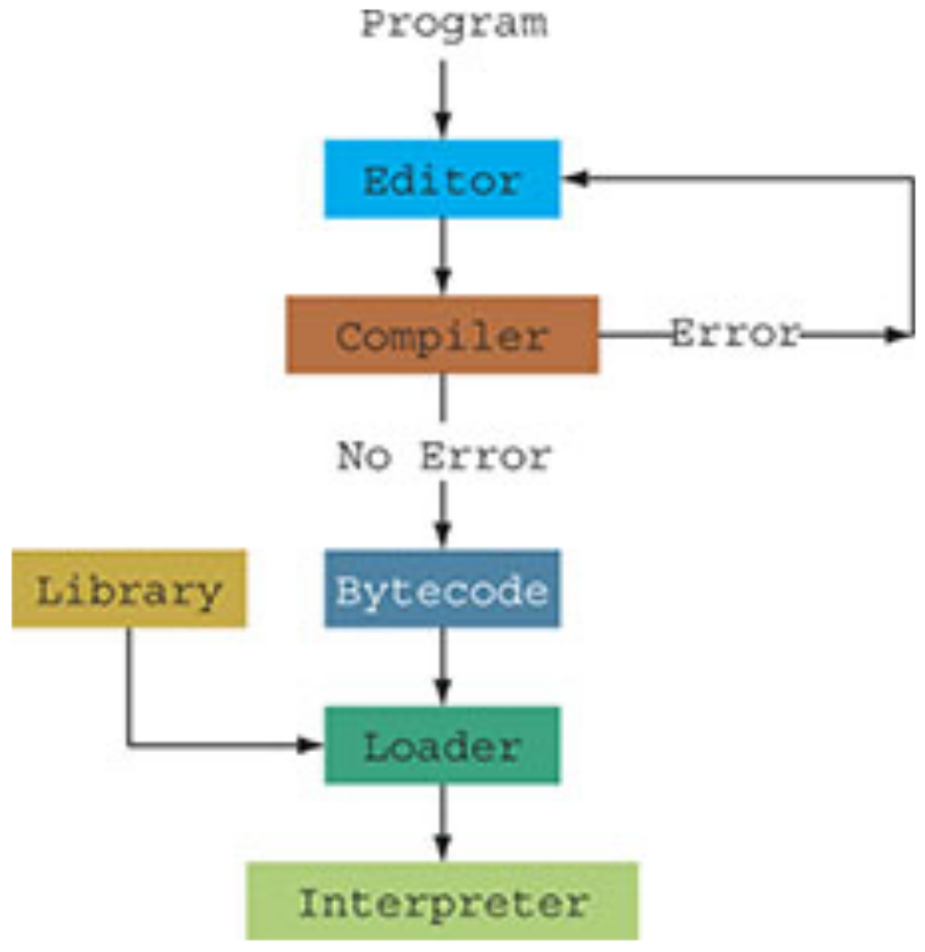
Processing a Java Program (continued)
Figure 1-3

Slide 28
Internet, World Wide Web, Browser, and Java
The Internet is an interconnection of networks that allows computers around the world to communicate with each other
In 1969, the U.S. Department of Defense’s Advanced Research Project Agency (ARPA) funded research projects to investigate and develop techniques and technologies to interlink networks
This was called the internetting project, and the funding resulted in ARPANET, which eventually became known as the “Internet”
The Internet allows computers to be connected and communicate with each other

Slide 29
Internet, World Wide Web, Browser, and Java (continued)
World Wide Web (WWW), or Web, uses software programs that enable computer users to access documents and files (including images, audio, and video) on almost any subject over the Internet with the click of a mouse
Computers around the world communicate via the Internet; the World Wide Web makes that communication a fun activity

Slide 30
Internet, World Wide Web, Browser, and Java (continued)
The primary language for the Web is known as Hypertext Markup Language (HTML)
Java applets are programs that run from a Web browser and make the Web responsive and interactive
Two well-known browsers are Mozilla Firefox and Internet Explorer
Java applets can run in either browser
Through the use of applets, the Web becomes responsive, interactive, and fun to use

Slide 31
Problem-Analysis-Coding-Execution Cycle
Algorithm: a step-by-step problem-solving process in which a solution is arrived at in a finite amount of time

Slide 32
Problem-Solving Process
Analyze the problem and outline the problem and its solution requirements
Design an algorithm to solve the problem
Implement the algorithm in a programming language, such as Java
Verify that the algorithm works
Maintain the program by using and improving it and modifying it if the problem domain changes

Slide 33
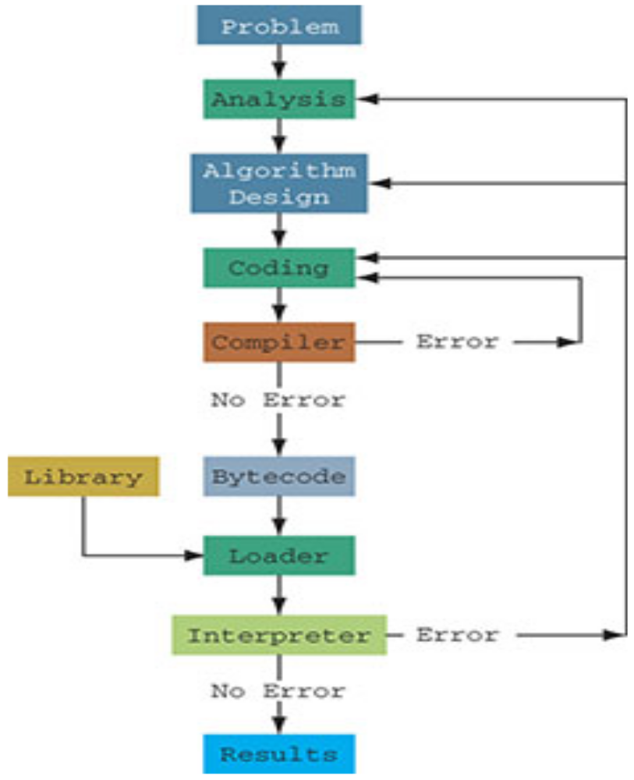
Problem-Analysis-Coding-Execution Cycle (continued)
Figure 1-4

Slide 34
Programming Methodologies
Two basic approaches to programming design
  Structured design
  Object-oriented design

Slide 35
Structured Design
A problem is divided into smaller subproblems
Each subproblem is solved
The solutions of all subproblems are then combined to solve the problem

Slide 36
Object-Oriented Design (OOD)
In OOD, a program is a collection of interacting objects
An object consists of data and operations
Steps in OOD
  Identify objects
  Form the basis of the solution
  Determine how these objects interact
Java Programming: From Problem Analysis to Program Design, 5e

Slide 37
Chapter Summary
A computer system is made up of hardware and software components
Computers understand machine language; it is easiest for programmers to write in high-level languages
A compiler translates high-level language into machine language
Java steps to execute a program: edit, compile, load, and execute
Java Programming: From Problem Analysis to Program Design, 5e

Slide 38
Chapter Summary (continued)
Algorithm: step-by-step problem-solving process in which a solution is arrived at in a finite amount of time
Three steps to problem solving: analyze the problem and design an algorithm, implement the algorithm in a programming language, and maintain the program
Two basic approaches to programming design: structured and object-oriented
Java Programming: From Problem Analysis to Program Design, 5e

